Slide 1


Engaging Differently
Notes:
Part of HIS – community engagement directorate, previously the Scottish Health Council
The world has gone through a massive upheaval in 2020, with most countries experiencing some sort of lockdown in response to the COVID-19 pandemic. Physical distancing restrictions have now been in place for some time and the situation has encouraged us to think differently about the methods we use to reach people to learn more about their views and experiences.
We are also acutely aware that important decisions continue to be made in relation to health and care services, and many at a faster pace than we have seen in the past - so what can we do to ensure that people and communities are continuing to have their voices heard and acted upon at such a crucial time?
In this webinar, staff involved in our Engaging Differently programme will explore how the pandemic has affected community engagement, describe examples of how organisations have adapted their approach to continue to meaningfully engage with people & communities, and share practical tips and resources to help people working in health and care consider changes they can make.
SYNCHRONOUS VS ASYNCHRONOUS

Slide 2
What’s community engagement?
Community engagement is a process of working collaboratively to discuss issues affecting wellbeing with an identified group of people who share a common interest, identity or place.
Meaningful engagement involves engaging people affected by a particular policy, event or change and ensuring people of all backgrounds can take part and have their voice heard and acted upon.
Notes:
About seeking views and experiences of people affected by decisions to inform those decisions or build an evidence base for future action

Slide 3
Why engage?
Community Engagement has many benefits:
Make fair decisions that matter to people
Encourage accountability and transparency
Improve services & service user outcomes
Develop safer care
Encourage healthier communities
Notes:
We want everyone to benefit from the improvements that we make to care
BUT if you are engaging think carefully about what you want to achieve from the engagement
What is the focus of the engagement and what has prompted it
If it’s to inform decision-making what can people getting involved influence

Slide 4

Digital Inclusion?
Lloyds Bank Consumer Digital Access Survey
(UK May 2020)
16% of the UK population cannot do basic digital activities such as turning on a device, connecting to wifi or opening an app by themselves.
People with an impairment are 25% less likely to have the skills to access devices and get online by themselves.
40% of benefit claimants have very low digital engagement.
Carnegie Trust - Learning from Lockdown: 12 Steps to Eliminate Digital Exclusion

Slide 5
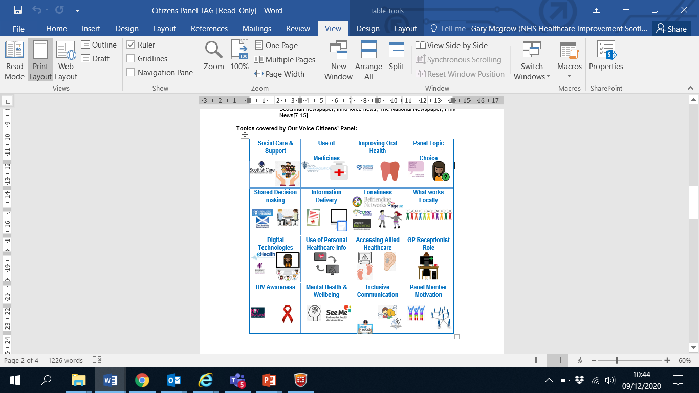
Citizens’ Panel
Methods used for feedback:
Electronic questionnaire
Postal paper questionnaire
Telephone Interview
Support offered – BSL and interpretation

Slide 6
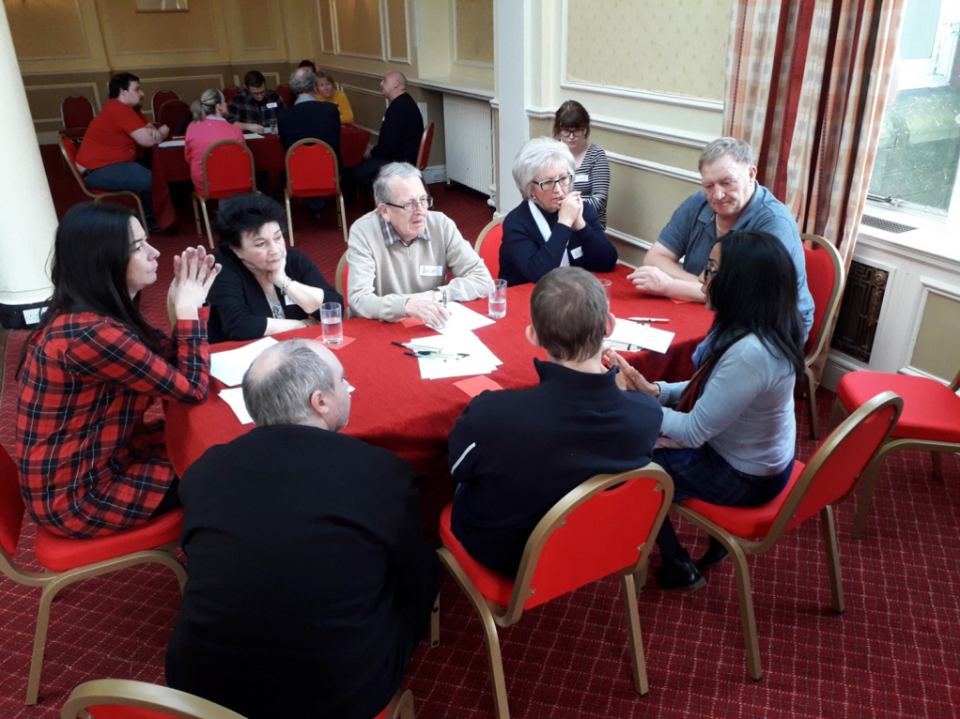
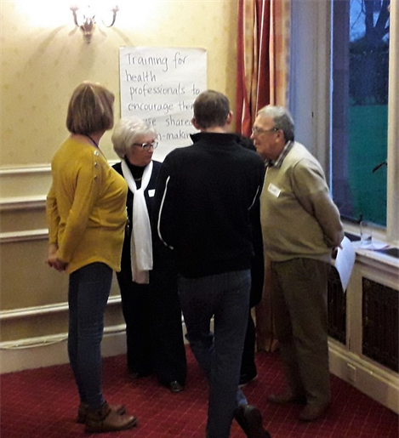
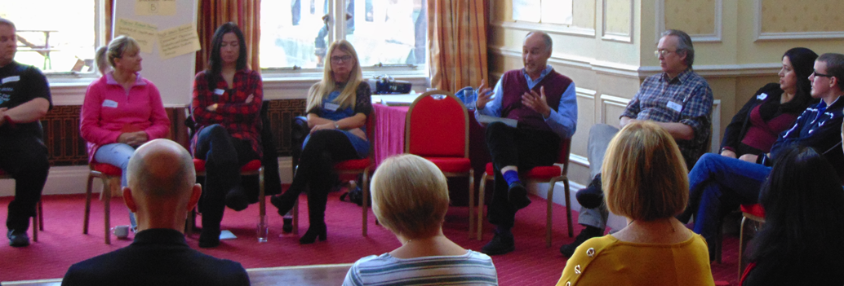
Citizens’ Jury

Slide 7
COVID-19 can’t stop engagement
Important decisions continue to be made to improve support for the people of Scotland - many accelerated by the COVID-19 pandemic
These decisions must be informed by the needs, views and experiences of people affected by them
Notes:
https://www.involve.org.uk/resources/knowledge-base/building-back-how-do-we-involve-communities-covid-19-response-and-1

Slide 8
What’s happening in health and care?
Access to vaccinations
How people access unscheduled care/urgent care
How people access primary care services, e.g. use of NearMe video consulting

Slide 9
What’s happening in health and care?
Options appraisal for new hospital
Inpatient services
How people with dementia are discharged from specialist dementia units
Action plans for mental health services
Notes:
https://www.health.org.uk/publications/long-reads/understanding-and-sustaining-the-health-care-service-shifts-accelerated-by-COVID-19
Webinar session
Community/primary care
Acute services
Nhs Lanarkshire – monklands – option appraisal
Highland/skye – reviewing inpatient/out of hours services – option appraisal
Mental health
Unscheduled care
NHS Highland- North Skye inpatient and community bed redesign
The review started in 2019 in response to Sir Lewis Ritchie’s recommendations for inpatient and Out Of Hours Care. Three community events took place at the beginning of this year before the option appraisal process was paused in March due to COVID-19. The process is due to restart in December and will complete in early 2021. The process will be conducted via Zoom to involve community representatives in the review of criteria and development of options. The case for change will be reviewed to take account of recent changes at Portree Hospital and Home Farm Care Home.
The local north Skye Community Trust will support the sharing of information with the wider community between the sessions.
NHS Lanarkshire – Monklands Replacement Project
NHS Lanarkshire published the outcome of the non-financial benefit scoring, financial appraisal, risk and sensitivity analysis end September and invited the public to provide feedback from 30th September to 18th October 2020. They commissioned a representative telephone survey of 500 people (with the majority recruited from the Monklands catchment area), ran online focus groups and telephone discussions and two focused surveys. They also updated the Fairer Scotland Duty assessment and shared this on their website. They received a total of over 760 responses.
Healthcare Improvement Scotland – Community Engagement has prepared an assessment report to confirm that NHS Lanarkshire has met the expectations set out in recommendations by the independent review panel and ourselves (2019). It has also followed national guidance to date in relation to public engagement and option appraisal on the Monklands Replacement Project. The report provides six recommendations for NHS Lanarkshire to inform next steps and highlights areas of good practice and learning.
Angus Health and Social Care Partnership - Review of Specialist Dementia discharge pathway

Slide 10
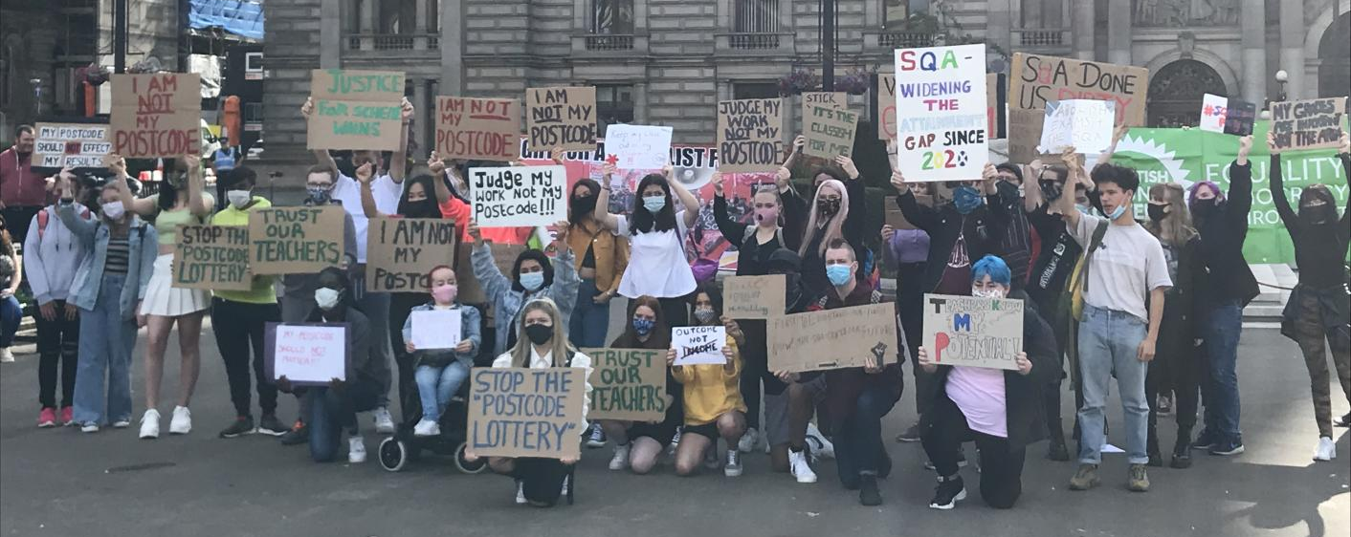
What happens when you don’t
“It is young people who are the most affected by this system, and they should always have been a part of determining how the SQA approached this year’s results.”
Children’s Commissioner
Notes:
We have seen the fallout from situations where COVID-19 has forced us to make decisions about how to do something differently but some decisions have not been fair because they have not taken into account all of those
SQA grading
“Children from more deprived areas report being downgraded, not based on an assessment of their own abilities and potential but on the historic performance of the school they attend.”
“The SQA’s refusal to discuss its proposed methodology in advance has resulted in conversations that could and should have taken place three or four months ago now having to happen at even greater pace, and against a backdrop of many children and young people experiencing significant anxiety and distress, not to mention the practical implications of missing out on university or college placements.”

Slide 11
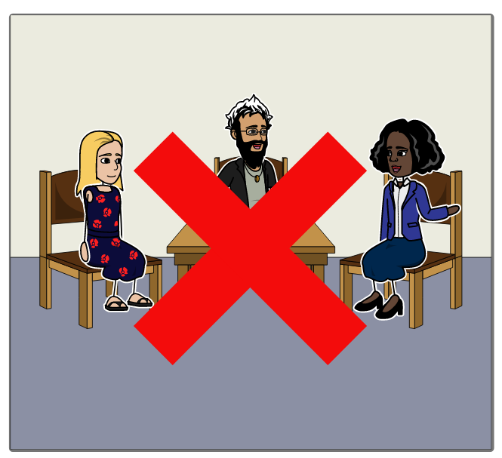
Not all options available to us…
Notes:
But not all of these options are currently available to us, certainly not in the physical proximity that we are used to

Slide 12
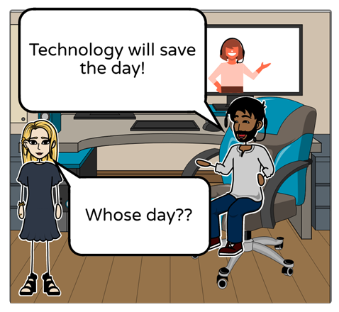
… but we can't solely rely on digital
Notes:
But not all of these options are currently available to us, certainly not in the physical proximity that we are used to

Slide 13
We need to offer a variety of ways for people to have their voice heard
Notes:
But not all of these options are currently available to us, certainly not in the physical proximity that we are used to

Slide 14

We need to be:
Notes:
We need to acknowledge the circumstances that we face, but also acknowledge the importance of finding ways to reach the people who are most likely to be impacted by the decisions we make.
The move to digital methods will make engagement easier for some to participate in and harder for others. We need to engage differently and that means we don’t use the same methods for everyone.
https://www.commonplace.is/blog/blending-online-and-offline-community-engagement?utm_content=141755211&utm_medium=social&utm_source=twitter&hss_channel=tw-1629851689

Slide 15
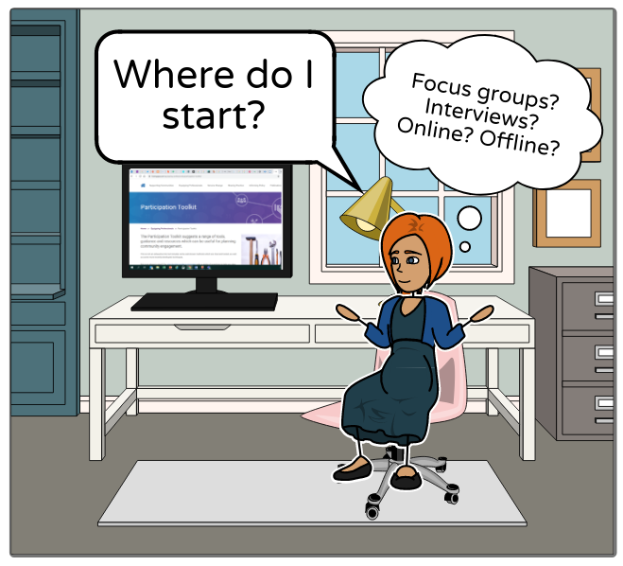
Where do you start?
Notes:
When faced with a wealth of different online and offline tools, choosing an appropriate approach for the communities you wish to engage with can be a daunting task
Asynchronous vs synchronous

Slide 16
Your approach needs to consider
How will you reach the people affected by your work?
How will they share their views and experiences?
How do we know what works for these communities?

Slide 17
Engaging Differently seeks to:
Meet the needs of health and care colleagues who are seeking information to inform decisions about how to engage with people and communities while physical distancing measures are in place.

Slide 18
Webpage
Created a webpage to provide advice, support, tools and tips

Slide 19
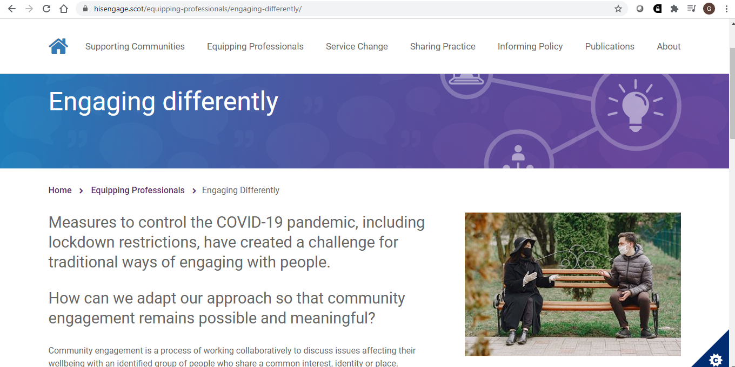

Slide 20
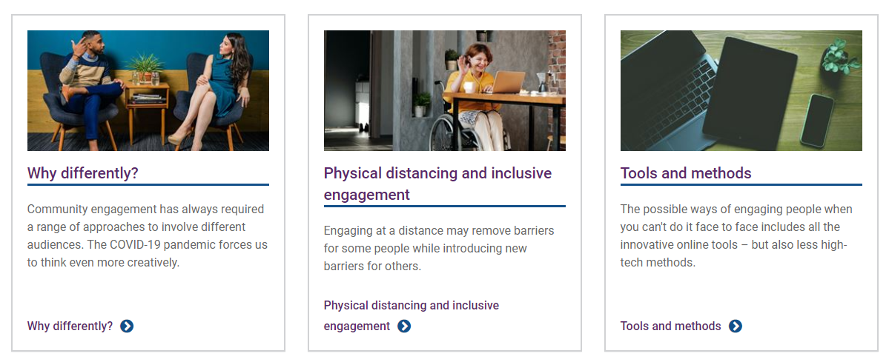

Slide 21
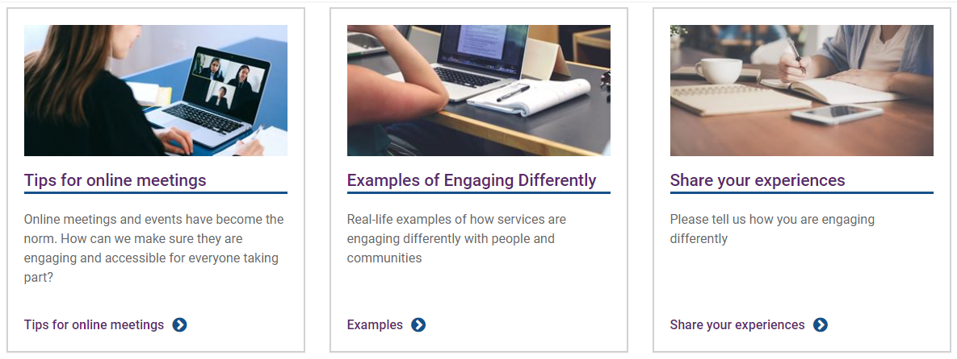

Slide 22
Case studies
Collected case studies showing how organisations have continued to engage with people and communities while physical distancing measures have been in place.
Notes:
We are particularly interested in any learning about how people who participated experienced the approach that was taken.

Slide 23
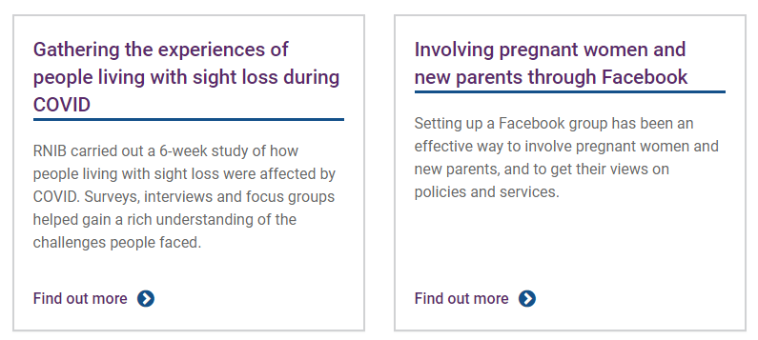
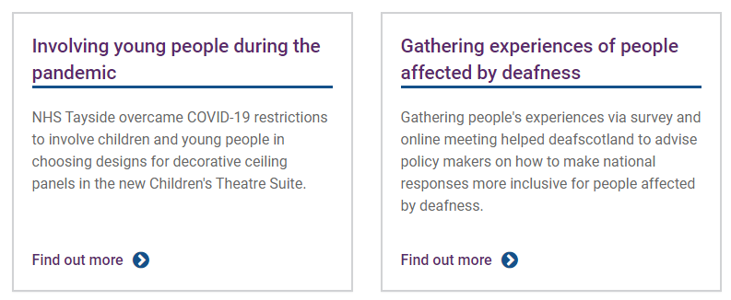
What have we done?

Slide 24
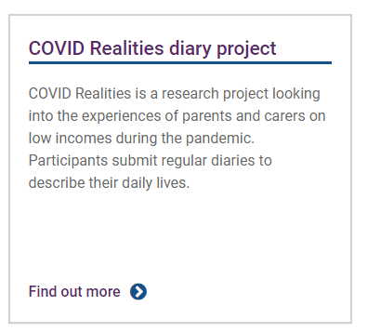
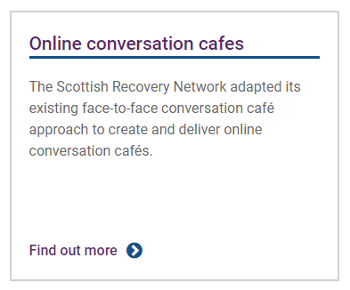
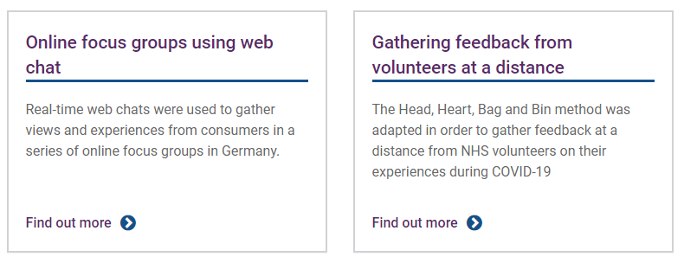
What have we done?

Slide 25
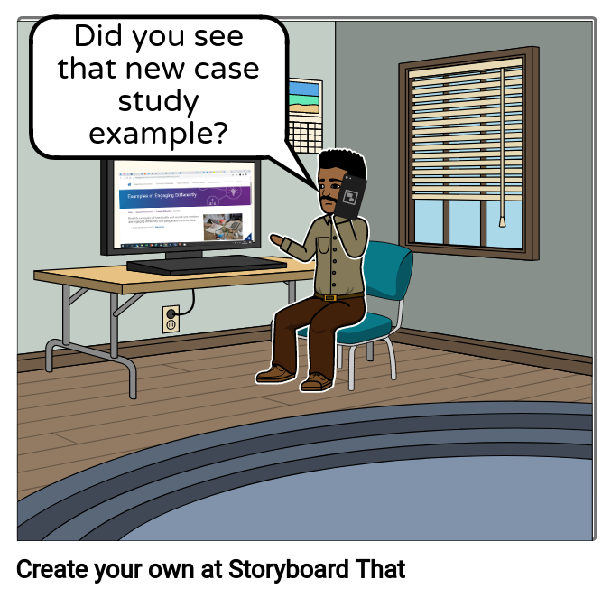
Our decisions can be informed by learning
Notes:
By looking at how organisations have been using different platforms, methods and tools, we can better understand appropriate considerations for different approaches

Slide 26
To share is to care
We need to pass on our learning
What worked well?
What didn’t work so well?

Slide 27
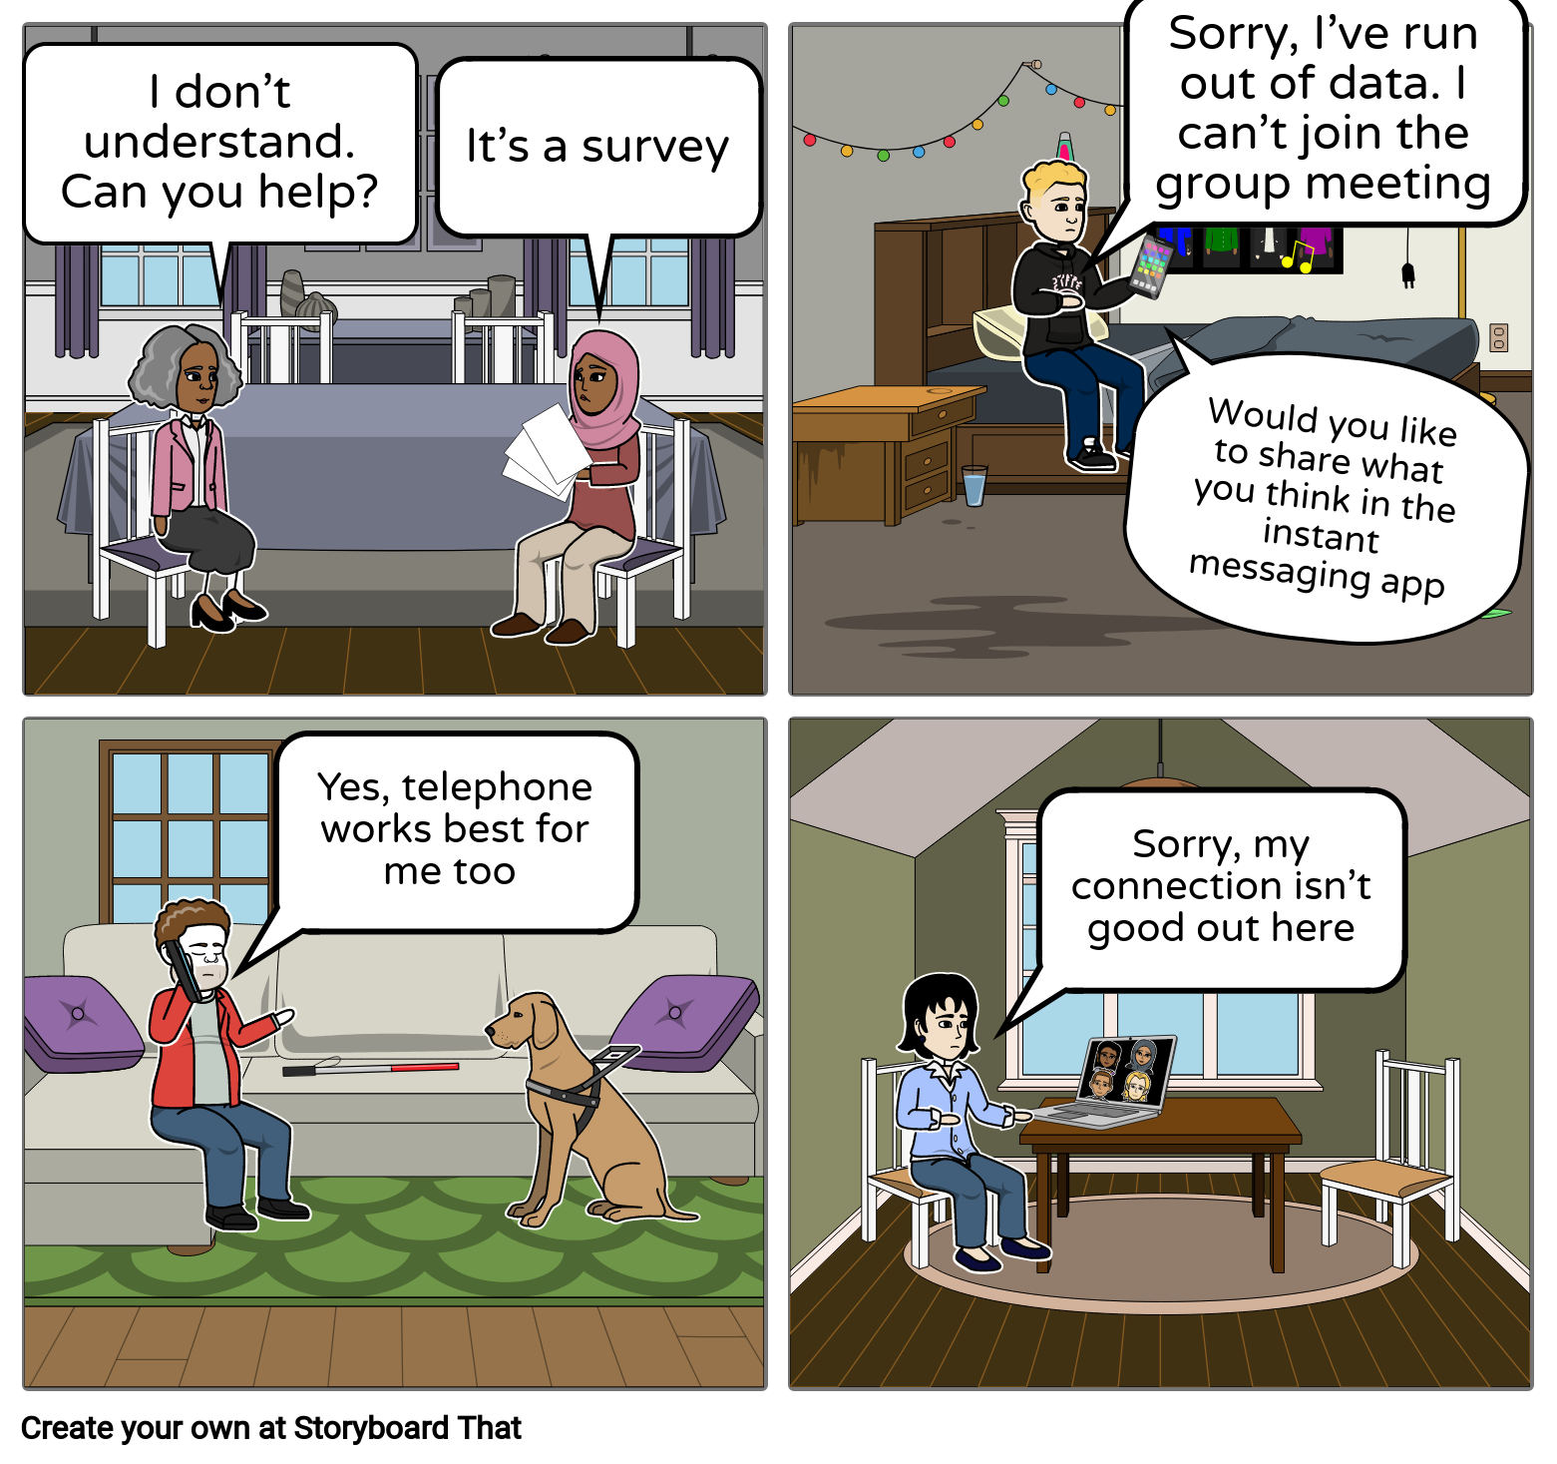
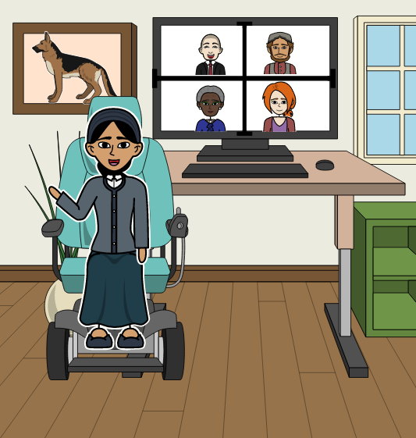
What works?
Notes:
Organisers rarely understand the issues that disabled people face (Attree et al 2011). Community engagement processes also often plan for participants to move about or stand or sit for long periods of time. This can be difficult not only for some disabled people, but also for older people (Edwards 2001). Video calls and other methods at a distance can overcome some of these issues.

Slide 28
What doesn’t?
Notes:
Issues for young people. Most have smartphones.
Might not have appropriate space to speak from. Might not be comfortable sharing video.
Care experienced young people are one of those groups most at risk of digital exclusion.

Slide 29
What doesn’t?
Storyboards created at Storyboard That
Notes:
Carrying out community engagement activities in familiar places (going to where the people are) is cited as a successful strategy for engaging with minority ethnic groups, but with limitations on the use of community spaces, trusted contacts (e.g. through places of worship) will become even more important in bridging links with people who may be otherwise isolated and thus underrepresented.
While questionnaires can be an effective way for people to have their views heard, Farooqi et al (2018) note that self-completion questionnaires sent to certain minority ethnic groups (e.g. postal surveys) often have poor response rates due to misunderstanding the purpose, or language/literacy issues. Actions such as including a translated cover sheet to allow respondents to request information in another language should be considered. However, translations may not always be cost effective.

Slide 30
Involving pregnant women and new parents through Facebook
Notes:
Title slide 2

Slide 31

Involving pregnant mums and new parents
Challenge to involve
  Short timescales
  Competing priorities
Traditional Maternity Services Liaison Committees (MSLCs) not very engaging
“Expert” service users a real asset
Also need current experiences
Photo credit: Anastasia Shuraeva on Pexels

Slide 32
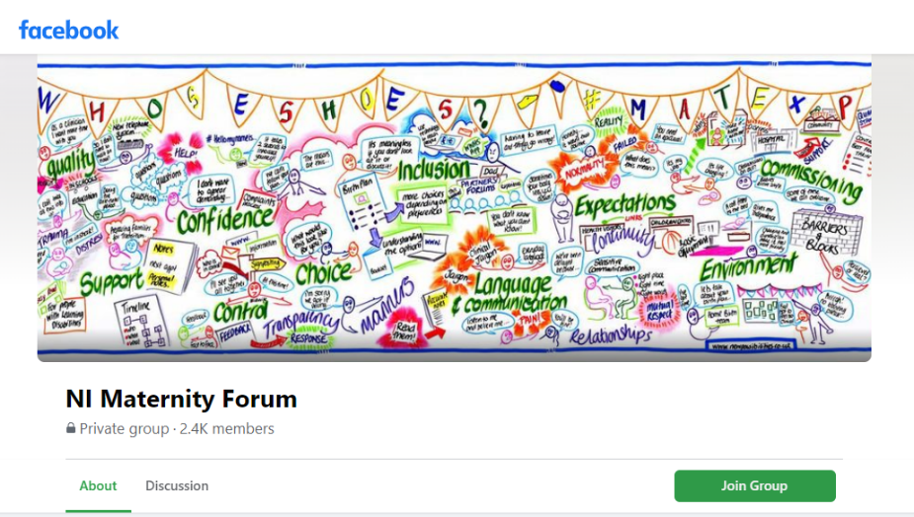
What they did
Changed MSLC to steering group
  Co-ordinating and identifying
  Short life working groups
New closed Facebook group
  2,400 members
  Peer support, health messaging, feedback to services
  Significant increase of communication during COVID

Slide 33

What has worked well
More engagement
Tailored to interests
Balance between established “experts” and new voices
More co-production
Real-time engagement with staff
Photo credit: Sebastian Voortman on Pexels

Slide 34
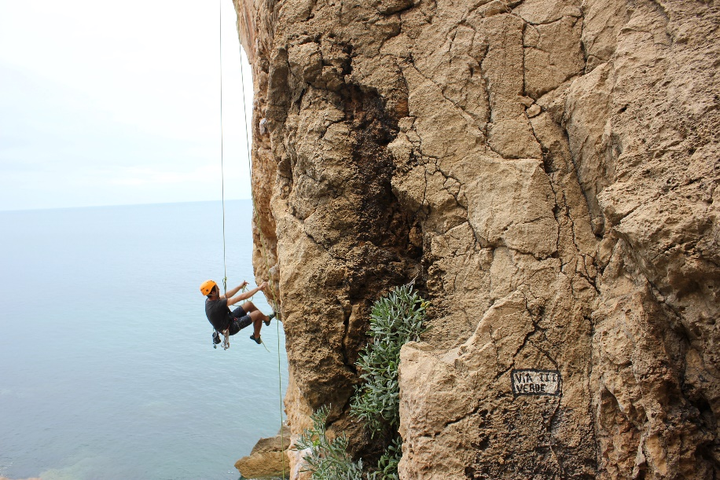
Challenges
Not all women use Facebook
Younger women
Language and literacy
Alternative channels
Requires staff/time investment
(Fear of) negative behaviour
Photo credit: Adel on Unsplash

Slide 35







Dealing with negative feedback on social media
Have a process
What type of
feedback?
Respond to everything
… within reason
Be patient and
helpful, make changes
Give your audience
a chance
Know when to
take it offline
Don’t take it
personally
Icons by Flat Icons on Flaticon
Notes:
Process: monitor mentions, know who to pass issues on to. Primary goal is to deal with the problem that caused the complaint, not the complaint itself
Identify the type of feedback: pressing issue, constructive criticism, disgruntled attack with merit, trolling/spam
Respond if appropriate: pressing/constructive = definitely; disgruntled = most; separate the content from the delivery; timely manner and with positivity; trolling/spam = best left alone
Be patient: be generous, give benefit of the doubt; apologise for inconvenience; offer a solution or explanation; every interaction is an opportunity
Give audience a chance: as long as the situation isn’t critical, leaving a bit of time can allow followers to act as advocates
Take offline: If a conversation starts to spiral, may be best to do 1-2-1. Have a range of channels ready. Best to be as transparent as possible, though
Don’t take personally: resist the urge to react emotionally; remember social media is destination #1 for people to vent steam

Slide 36
Engaging Differently case study:
Involving young people during the pandemic
Notes:
SLIDE 2
This case study is from the ‘New Children’s Theatre Suite Project Team’ at NHS Tayside.
And we’ve chosen it, not because I’m based in Tayside and am biased, but because while many people struggle to engage with children and young people in normal times, this project team managed to do so right in the middle of the full lockdown earlier this year. It’s also a good example of going to where people are, rather than expecting them to come to you.
SLIDE 3
First I thought I’d share a little background to this engagement –
There has been only one dedicated children's’ theatre in Tayside (based in Ninewells Hospital) and so a large proportion of operations (in fact, about 50%) on children has had to take place in adult theatres – everybody knew this wasn’t ideal.
A few years ago it was agreed to build not only a second dedicated children's theatre but the creation of a first class children’s theatre suite within the Tayside Children’s Hospital, designed and built for children and their families with significant input from them. The Archie Foundation came on board to raise funds and share ideas to make sure the new suite is a child-friendly and age appropriate space…you may have seen the Oor Wullie bucket trail throughout Scotland last year – this is one of the main projects it was raising money for.
From the beginning the project team has involved children, young people and their families in how the new suite should look but this definitely became more challenging with the arrival of Covid 19….
SLIDE 4
However building had continued during the pandemic and there were skypanels to choose - colourful decorative panels that would be installed on the ceilings of the ward, anaesthetic rooms and corridors. A suite of images had been developed and the Project Team wanted to involve children and young people in selecting the final skypanel designs. So they had to put their thinking caps on and find ways of reaching them, and at a time schools were not meeting.
SLIDE 5
They’d heard about the network of Community Support Centres that had been established throughout Dundee in response to the pandemic - these provided coordinated support as well as childcare for children of key workers and vulnerable children.
They also made contact with the leader of a local scouting group which they’d heard was meeting virtually. Contacting the local education department also enabled them to link into a School Care Hub and a School’s Out Club. Altogether, 5 key groups of children and young people were identified.
SLIDE 6
Because the project team weren’t able to meet with the children face to face, the group leaders were provided with an information pack containing - background information on the project, a plan showing locations of the skypanels, a list of skypanel design options, a voting sheet, and guidance on involving the children and young people in selecting their preferred options. Responses were requested by a specific date and all of the groups approached submitted their votes.
The Project Team reviewed the results and approved the selection of the skypanels which received the greatest number of votes.
All of the groups who had participated were then contacted to let them know which panels had been chosen and thank them again for their involvement.
SLIDE 7
Where there any challenges?
Well, there was one in particular -
To make it easy for the organisations to be involved, they were given the option of how to send the votes back. Some sent individual scanned voting sheets, others created their own electronic version, one sent hard copies. But this meant collating the votes was an arduous and time-consuming task which could have been made much simpler if a standard method had been used.
SLIDE 8
What worked well?
134 children and young people took, a higher number than initially expected
Children and young people from a variety of backgrounds were involved. This included ones who were being cared for in the Community Support Centres – that is, the children of key workers and vulnerable young people who had been identified by Dundee City Council
The selections chosen by the children & young people directly influenced the panels to be purchased and installed
As you can imagine, in what was a worrying time, taking part in the engagement was a welcome distraction for the children and young people
Actively going to where children and young people are was so successful that in the future the team will consider how to engage with a greater number of schools and youth groups
SLIDE 9
And this is what it was all about – some of the skypanels that the children and young people chose – these will decorate the ceilings in the corridors, anaesthetic rooms and wards of the new children’s theatre. It is hoped that by May 2021 the build will be complete and the skypanels will be there to provide a calming distraction for children who are anxious but also to capture children's imagination.
SLIDE 10 You can find this case study on the Engaging Differently section of the HIS:Engage website

Slide 37

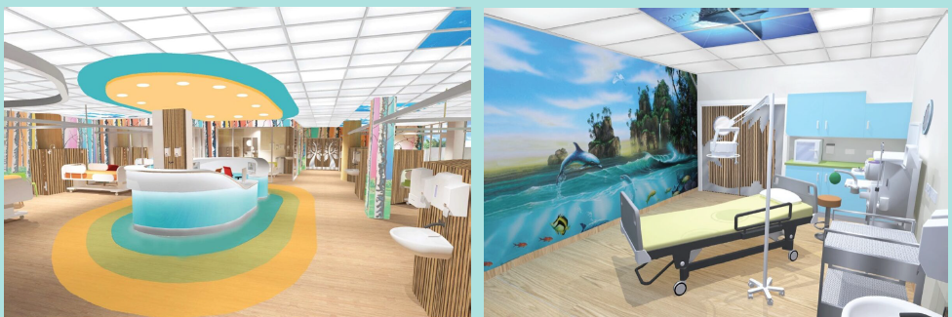
INVOLVING YOUNG PEOPLE DURING THE PANDEMIC
New Children’s Theatre Suite Ninewells
Involving children & young people
Going to where people are

Slide 38
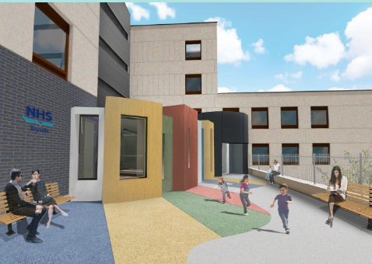

PROJECT BACKGROUND
One children’s theatre for Tayside
Build 2nd dedicated children’s theatre
Whole new children’s theatre suite
Archie Foundation
Involved children, young
people & families all the way
through

Slide 39


SKYPANEL ENGAGEMENT
Engaging during Covid-19
Skypanels to select
Suite of images
Children & young people to select final designs
How to reach and involve during
a pandemic?

Slide 40
SKYPANEL ENGAGEMENT
5 key groups identified
2 x Community Support Centres
local scout group - virtually
out of school club
school care hub

Slide 41



SKYPANEL ENGAGEMENT
Information pack shared with group leaders
Background, architect plan, list of options, voting sheet, guidance
Votes submitted & processed
Groups advised of favourites

Slide 42
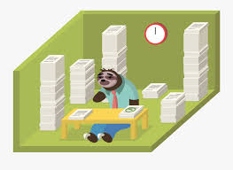
SKYPANEL ENGAGEMENT
CHALLENGE
Collating votes arduous & time-consuming
Standard method in future

Slide 43
WHAT WENT WELL?
134 children & young people
Wide variety of backgrounds
Directly influenced panels purchased
Welcome diversion for children and young people
Will inform future engagement

Slide 44
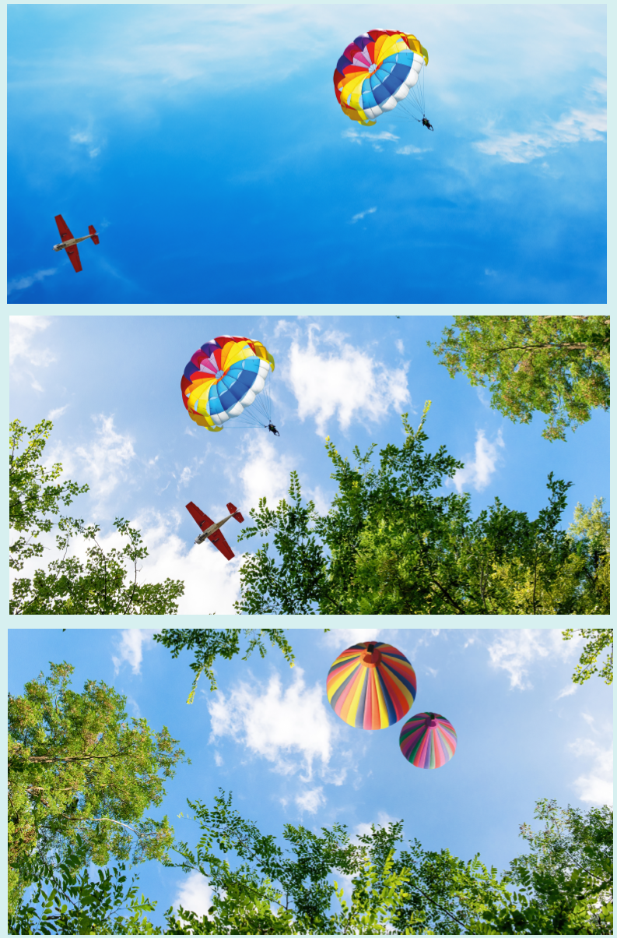





Slide 45
FOR MORE INFORMATION
https://www.hisengage.scot/equipping-professionals/engaging-differently/examples/involving-young-people-during-the-pandemic/

Slide 46
We want to know:
What would support you?
Are there any methods/platforms you are interested in?
Are there any particular groups you wish to engage with?
Do you have any examples to share?

Slide 47
Thank you and keep in touch ☺
Twitter: @HISEngage
Email: info@hisengage.scot
Web: https://www.hisengage.scot/
Hashtag: #EngagingDifferently
Supporting better quality health and social care for everyone in Scotland

